Slide 1
IPL MATCH WIN PREDICTION
PRESENTED BY-
GURUNATH JAGDHANE
ATHARVA VARDHE
RAVINA JINGARE
TEJAL BHOSALE
GUIDED BY-
RITVIZ SINGH
SHIV SINGH PATEL

Slide 2
INTRODUCTION
IPL (Indian Premier League) is a highly popular professional Twenty20 cricket league in India. With the increasing popularity of cricket and the IPL, there has been a growing demand for accurate match predictions. Machine learning can be used to develop an IPL match prediction system that can analyze the past performance of teams, players, weather conditions, and other relevant factors to predict the outcome of a match.

Slide 3
OBJECTIVES
The objective of an IPL match win prediction project is to develop a predictive model that accurately forecasts the outcome of Indian Premier League (IPL) matches. This involves analyzing historical match data, player statistics, team performance metrics, and other relevant factors to identify patterns and trends that can help predict the likelihood of a team winning a match. The ultimate goal is to create a reliable model that can assist cricket enthusiasts, sports analysts, and betting enthusiasts in making informed decisions about match outcomes.

Slide 4
WHY WE CHOOSE THIS TOPIC
Entertainment: People enjoy the excitement and thrill of predicting the outcome of sports events, including IPL matches. It adds an extra layer of excitement to watching the games.
Competition: Prediction contests, whether among friends, colleagues, or online communities, create a sense of competition and engagement. It's fun to compete with others to see who can make the most accurate predictions.

Slide 5
ATTRIBUTE SELECTION
The main attributes like-
Batting Team
Bowling Team
Host City ( Stadium )
Target
Score
Overs completed
Wickets Out

Slide 6
WORKFLOW
DATASET COLLECTING
The first step in building an IPL match prediction system using machine learning is to collect and preprocess the data. The data can include historical match data, team and player statistics, weather conditions, pitch conditions, and other relevant information.
After the model is trained, it can be used to predict the outcome of a match by inserting the relevant data for the upcoming match. The model can provide a probability of the outcome, such as the probability of a team winning or losing the match.
DATA CLEANING
ATTRIBUTE SELECTION
DATA MINNING
ANALYSIS RESULT

Slide 7
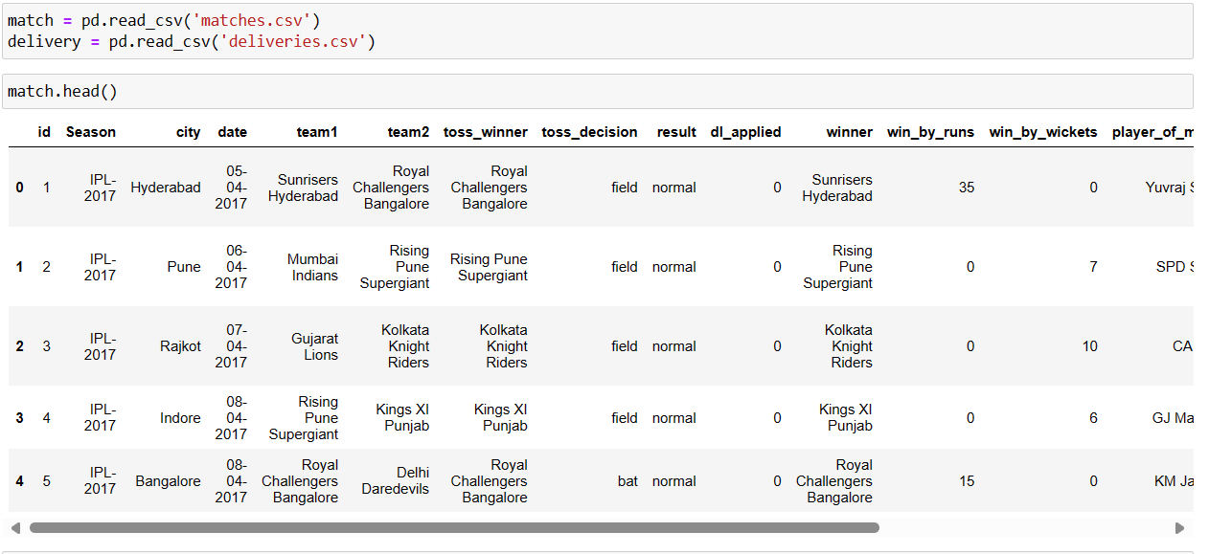
DATA SET
Here we collected data from Kaggle which contains the details regarding the winner and match stats.
It contains the details like teams played, winner, venue of the match, won by how many wickets and runs, toss decision, whether DLS applied or not, names of the umpires etc.

Slide 8

IMPLEMENTATION
The first step is importing all required libraries.
import pandas as pd
import numpy as np
import seaborn
import matplotlib.pyplot as plt
import sklearn
Let’s import the dataset. We’ve already discussed the dataset.

Slide 9
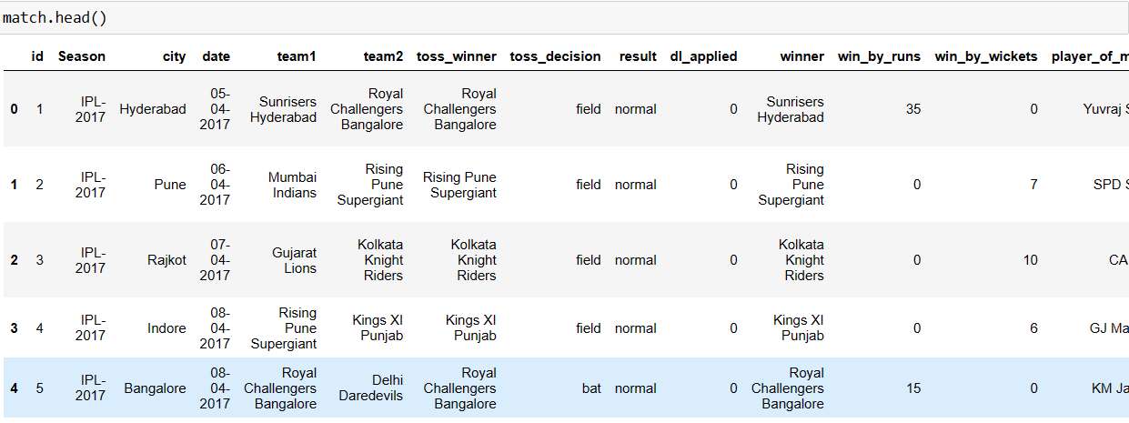
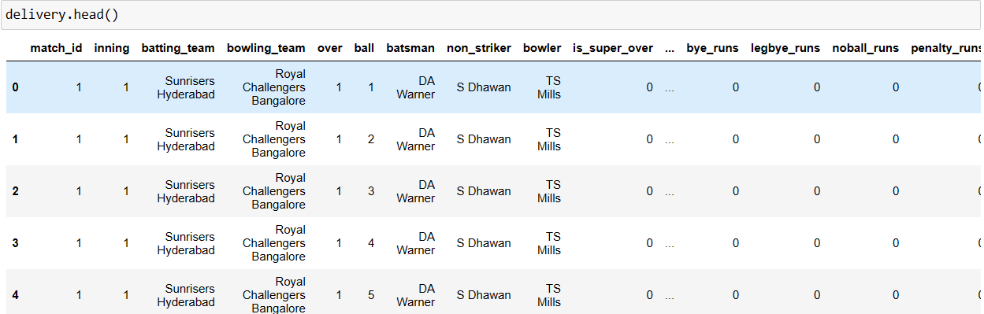
IMPLEMENTATION
first 5 rows data.head()

Slide 10
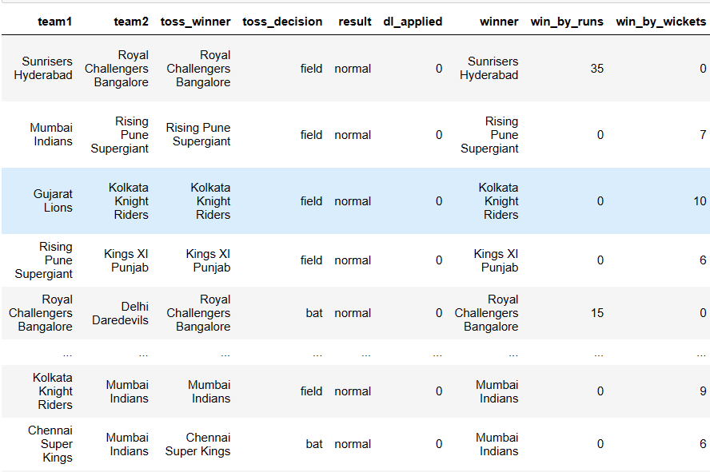
IMPLEMENTATION
We don’t need all the features or columns in order to create the model. so we are dropping some of the features that don’t affect our result.

Slide 11
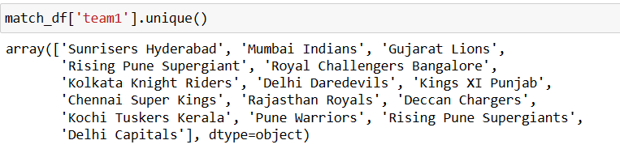
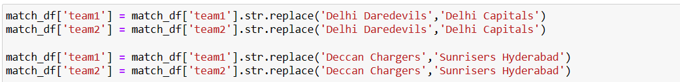
IMPLEMENTATION
Now let’s look into the total teams listed in this dataset
Here you can see the name Delhi Daredevils and Delhi Capitals; Delhi Daredevils is old name of the Delhi Capitals and Similarly Deccan Chargers. So we are changing the old name to the newer one.

Slide 12
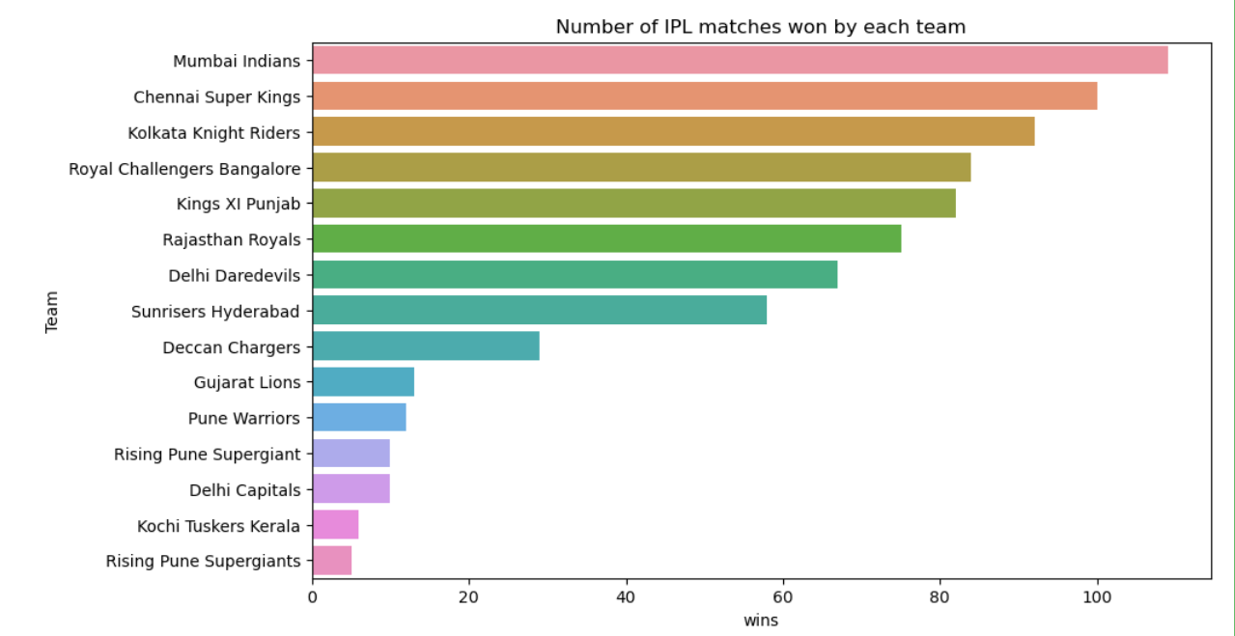
EXPLORATORY DATA ANALYSIS
VISUALIZATIONS
Number of IPL matches won by each team
Countplot

Slide 13
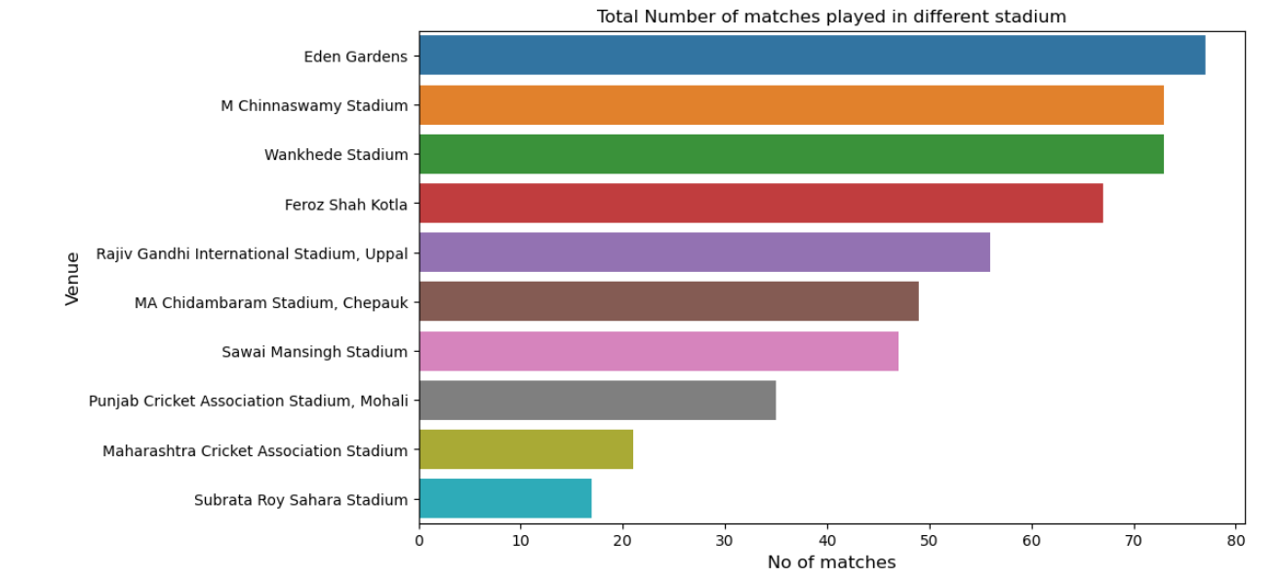
EXPLORATORY DATA ANALYSIS
VISUALIZATIONS
Total number of matches played in a different stadium

Slide 14
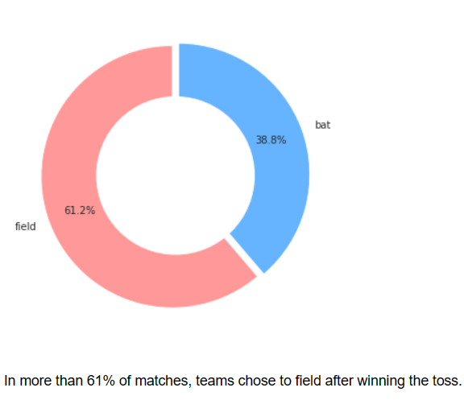
EXPLORATORY DATA ANALYSIS
VISUALIZATIONS
The decision was taken by the toss winning team
Pie Chart

Slide 15
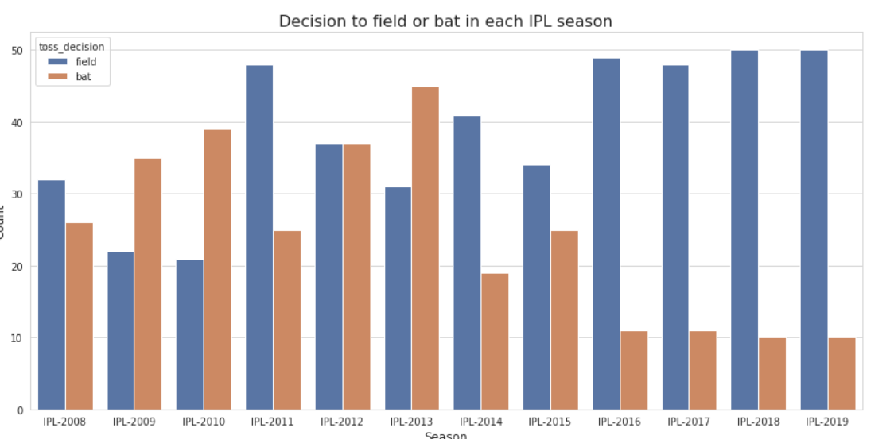
EXPLORATORY DATA ANALYSIS
VISUALIZATIONS
Toss decision to field or bat in each IPL season

Slide 16

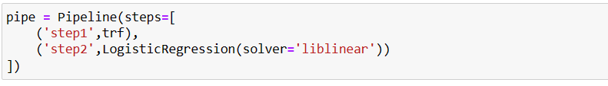
MODEL CREATION AND EVALUTION
Now let’s convert our data into a training set in order to create the model and test set for evaluating the created model.
The next and most important step in the model creation step. So we are using –
Random Forest Classification
Logistic Regression
Pipeline

Slide 17

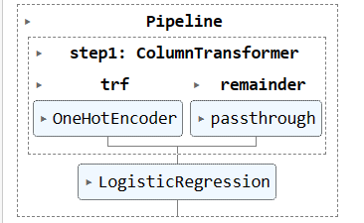
MODEL CREATION AND EVALUTION
Training the random forest classifier model

Slide 18


MODEL CREATION AND EVALUTION
Predicting the model with x_test values and saving it as y_pred
Using the accuracy score of sklearn, we are evaluating the predicted result and accuracy of the model

Slide 19
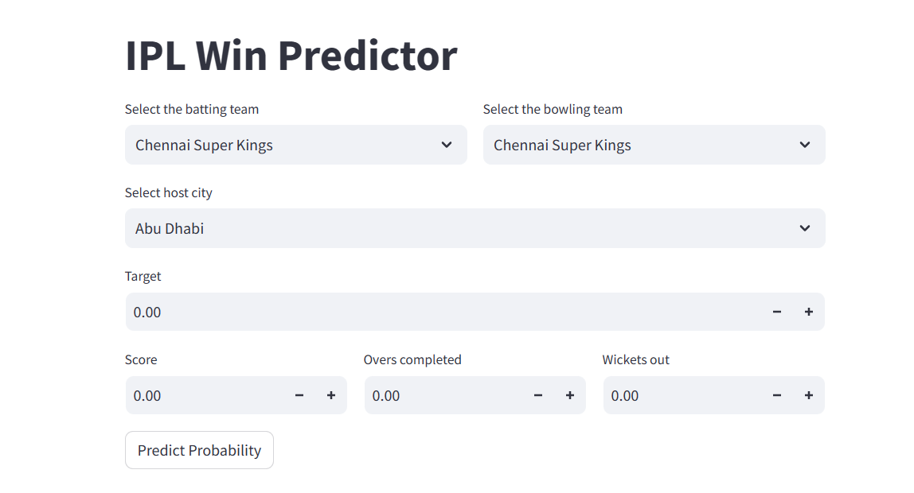
FINAL OUTPUT OF PROJECT
GUI OF PREDICTOR

Slide 20
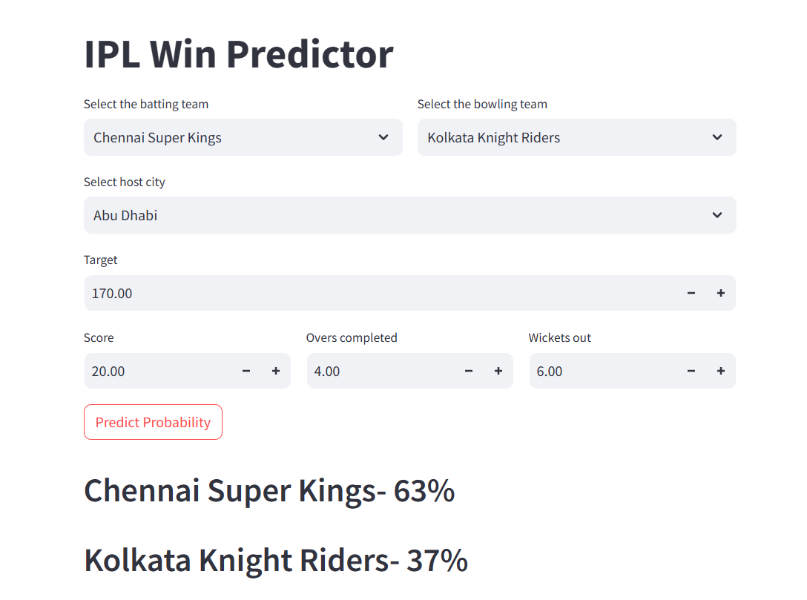
FINAL OUTPUT OF PROJECT
FINAL OUTPUT WITH THE RESULT

Slide 21
CONCLUSION
You have got an insight into how to analyze a given raw data and convert that into useful features by removing unwanted features, that is, performing exploratory data analysis.
IPL Dataset analysis : This analysis includes checking for null values , describing the dataset’s features columns, and analyzing each feature.
Visualization of data: Done a graphical representation of the dataset in order to get an understanding of the teams, matches and the toss decision of the IPL Matches.
Performed preprocessing techniques on the IPL Data: Performed several feature engineering techniques in order to make the dataset suitable for making the model.
Model creation and Evaluation: This was the main part of the project, and we used the RandomForestClassifier model. Later we tested this model with the test set for evalution.

Slide 22
THANKYOU!!

